Slide 1
HS1917 CyberSecurity

Slide 2
Good Faith Policy
Be Ethical, Don’t Be Unethical
This class will teach both attacker and defender mindsets
We expect a high standard of professionalism from you, Meaning:
Respect the property of others and the university / your school
Always abide by the law and university / school regulations
Be considerate of others to ensure everyone has an equal learning experience
Always check that you have written permission before performing a security test on a system
If you are unsure about anything ask one of the course staff!
Notes:
Be ethical, don’t be unethical
Do this with any systems you don’t own (or any parts of systems you don’t own) can get you sent to jail

Slide 3
Define: Hack
Verb - English - /hak/
‘To use or manipulate a system in a way in which it was not originally intended’
Notes:
No mention of code there
No mention of a computer
“hack something together”, “hacky fix” – All implying that it’s not been done the way it was meant to
Earliest hackers – phreakers – phones – google this story

Slide 4
Protect your base
What makes your house safe from burglars?
Notes:
Standard house activity
Be a defender – how do you make it safe?
So it’s safe now?
OK, be attacker now
Oh look, it wasn’t safe

Slide 5
General Security
Who has a good password?
Who has a housekey?
Who locks their door?
Notes:
Tell them what their password looks like
Where do they leave their housekey? Ever in their schoolbag?
Lock picking kits and practice locks exist ,and are cheap to buy online

Slide 6
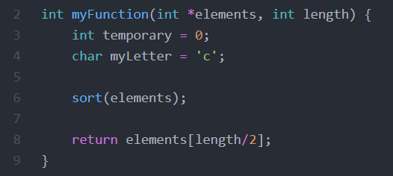
Remembering C Functions
Notes:
Pass things in – these parameters are stored in stack
General structure:
Local variables – stored in stack
Processing / stuff / code
Return result

Slide 7
Live Demo

Slide 8
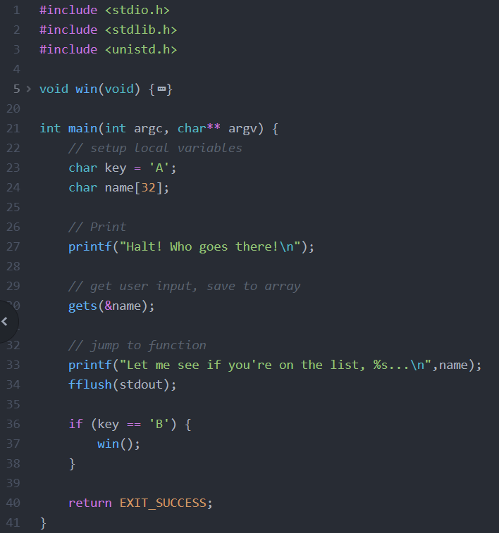
Notes:
Capture the flag – we want to call win()
I will publish this compiled binary somewhere
What have we got?
Run the code and see
So `key` is set and never changed, ok
Ok, so what do we control?
User data with gets() – look up the manual
Buffer overflow

Slide 9
Data Entry
How do we enter data in a computer?
What does the computer do with this?
Remember ASCII tables?
There are other ways the computer stores data
How do we format data?
Notes:
We usually enter data in a computer as letters and numbers
The computer decides how to store this data
It usually ‘packs’ data so that is easier to store and manipulate – like putting something in a box a certain way
Sometimes we need our data to be packed if we’re doing sneaky deaky stuff, so that the computer can read it the way it expects to
I’m too lazy to do this by hand – I use tools to do this (python module named ‘pwntools’)

Slide 10
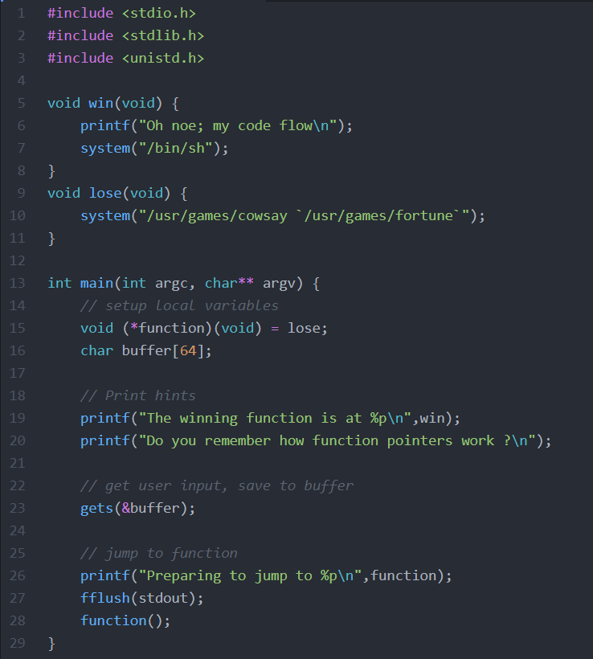
Notes:
What have we got?
Run the code and see
Win, lose, main functions
Explain the `void (*function)(void) = lose` line – this is a function pointer – a pointer which points to code, rather than a variable as we have done before
Ok, so what do we control?
User data with gets() – look up manual

Slide 11
Finding bugs in C
GDB > printf()
Takes time to learn to use, but makes segmentation faults easy to fix
Notes:
How do we find where bugs are?
printf(), right?
Naaaaa, isn’t great.
Gdb
Now we’re cooking

Slide 12
Live Demo

Slide 13
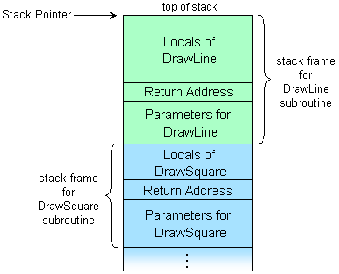
I got stacks on stacks on stacks on stacks
(Last week’s lectures)
Do you want me to review stack frames? They’re important here
We say that stack frames grow down
Notes:
structure: https://stackoverflow.com/questions/10057443/explain-the-concept-of-a-stack-frame-in-a-nutshell
Stacks grow upward – like a stack of pancakes
Image src: https://cs.anu.edu.au/courses/comp2300/lectures/week-5/#/title

Slide 14
What was I just doing again?
Ever walk into a room and forget why you’re there?
What happens when we run `return EXIT_SUCCESS;`?
How do we know the return pointer is ok?
Notes:
What does return do?
Finds the ‘Return Address’/’Return Pointer’, and goes to that address, which will be another stack frame
How do we know the return pointer is ok? – we don’t. We just trust it

Slide 15
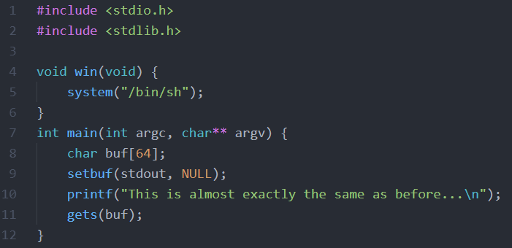
Notes:
blind.c
Run the code – almost the same as before.
What is this doing in main? Focus on gets() and post-’gets()’
Whats different?
No printing info – so we do it blind with AAAABBBBCCCCDDDD….
Using GDB to see what it’s returning to

